Slide 1




Tatiana
Jan
Blair
Holly

Slide 2
Exploring subgroups visually:
A first step in identifying nuanced differences
and telling a more complete story
Presenters:
Blair Beadnell,
Holly Carmichael Djang,
and Tatiana Masters
October 27, 2016
Chair: Jan Vanslyke

Slide 3
Structure and purpose
We will be interweaving our three presentations
First, we will discuss
  When and why?
  Ways of identifying subgroups
  Then, we will show examples of
  Identification
  Analysis
  Visualizing findings
Finally, considerations when doing subgroup analysis

Slide 4
Subgroups:
What, When, Why?
B

Slide 5
What is subgroup analysis?
Commonly useful and requested in program evaluation work
Looks beyond the full sample to:
Examine characteristics of subgroups separately
OR
Compare subgroups to each other
Simple examples of subgroups
    Females and males
    Race/ethnicity groups

Slide 6
When can you do it?
In qualitative or quantitative work
Using one or multiple timepoints
Today’s focus:
Quantitative subgroups…
…but some concepts apply to both
In longitudinal examples, two timepoints…
…but ideas can be extended to more

Slide 7
Why should I conduct subgroup analyses?
To answer evaluation questions such as:
  How do groups differ on important characteristics or behaviors?
  Do some groups benefit more or less from a program than others do?
  Examples today:
  Sexual safety behavior among sexual minority youth
  Early childhood education center quality
  Quality of school food
  Risky drinking and related cognitive variables

Slide 8
How subgroup analyses help
Program development
Previous research on subgroups can help develop targeted content
Program Improvement
Subgroup analyses can identify types of people not benefitting from an intervention who it needs to better address

Slide 9
How:
Defining Subgroups
T

Slide 10

How do you define a subgroup?

Slide 11
The analyst…
Groups people by scores on one or more variables
OR
Performs statistical analyses
that group people
based on 3 or more variables

Slide 12

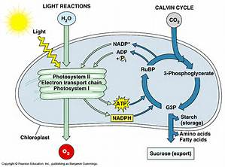
Subgroup analyses can range from
simple…
…to complex

Slide 13
How do you group…
…based on one variable’s values?
Example:
Sexual safety practices
among sexual minority youth

Slide 14
Used Barriers
Two groups:
Did youth talk with partners about using barriers (condoms or dental dams)?
Group 1: No
Group 2: Yes

Slide 15
How do you group…
…based on two variables’ values?

Slide 16
Did youth discuss any approaches to sexual safety, either:
Using barriers (condoms or dental dams)?
Getting STI tests?
Used Barriers
Agreed to get STI tests

Slide 17
Did youth discuss any approaches to sexual safety, either:
Using barriers (condoms or dental dams)?
Getting STI tests?
Two groups
Did not talk about barriers or testing
Talked about one or both strategies
OR…
Used Barriers
Agreed to get STI tests

Slide 18
Used Barriers
…Four groups!
 | Barriers | STI Tests
Group 1 | No | No
Group 2 | Yes | Yes
Group 3 | No | Yes
Group 4 | Yes | No
Agreed to get STI tests

Slide 19
What about groups based on more variables?
Situation 1
Have general idea what subgroups exist…
Situation 2
No clear theory about what subgroups exist…
but do not know how variables combine to create them.
just know relevant variables to use.
Exploratory!

Slide 20
Used Barriers
Talked about safer sex
Agreed to get STI tests

Slide 21
Used Barriers
Talked about safer sex
Agreed to get STI tests
Other sexual safety strategies

Slide 22
Used Barriers
Talked about safer sex
Number of Partners
Agreed to get STI tests
Other sexual safety strategies

Slide 23
Sexual Safety Profile
Number of Partners
Used Barriers
Talked about safer sex
Other sexual safety strategies
Agreed to get STI tests

Slide 24


Slide 25
Examples:
The Analyst Decides
on Grouping
H

Slide 26
Data visualization is a big help!
Before statistical analyses,
helps guide selection of analysis strategy.
After analyses are done,
guides interpretation of findings.
Helps communicate results to stakeholders.

Slide 27
Subgroup: One variable; one point in time

Slide 28
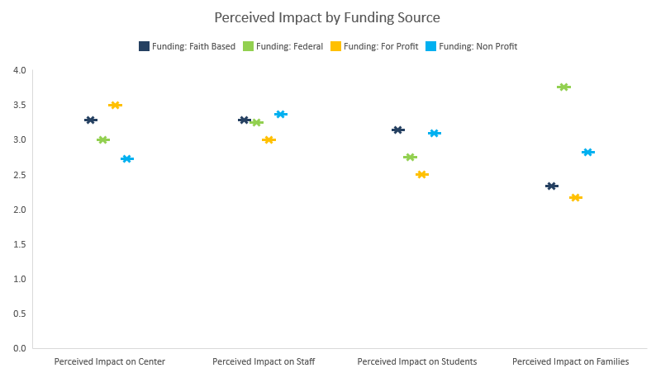
Subgroup: One variable, one point in time

Slide 29
Subgroup: One variable, two points in time

Slide 30
Using several variables: very simple example
Analyst created a simple categorization based on 4 variables:
Did these occur in the last 90 days?
  used drugs
  occasionally drank 4+ drinks
  typically drank 4+ drinks
  drove under the influence of alcohol or drugs
Analyst grouped people as engaging in 0, 1, 2, 3, or 4 of these (at preintervention and postintervention).
B

Slide 31
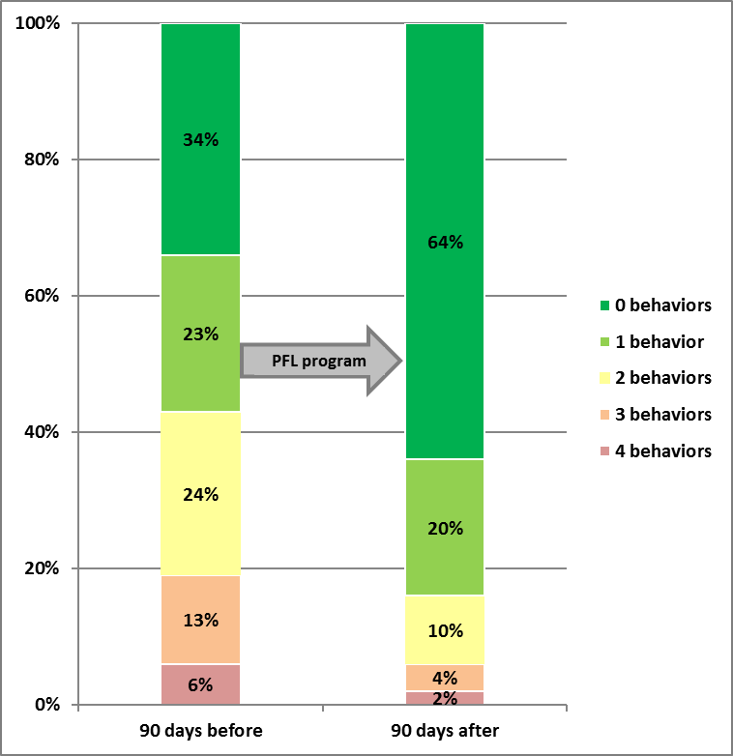
Subgroup: Based on 4 separate behaviors
Number of high risk behaviors 90 days before and after program

Slide 32
Examples:
The Analyst Performs Statistical Analysis to Identify Subgroups
T

Slide 33
Latent Class Analysis (LCA) is…
A statistical method
for using multivariate data
to empirically identify
subgroups within a population.

Slide 34
People in a subgroup…
In terms of their responses on a set of variables, are:
like people in the same group
and
different from people in other groups.
SUBGROUP = LATENT CLASS = PROFILE

Slide 35
Sexual minority youth LCA
425 self-identified LGBTQ youth
Online survey of health-related behavior (2008)
14 to 19 years old
Male and female youth analyzed separately
Research supported by a grant
from the National Institute of Mental Health
(R21 MH 075030-02) to Blair Beadnell

Slide 36
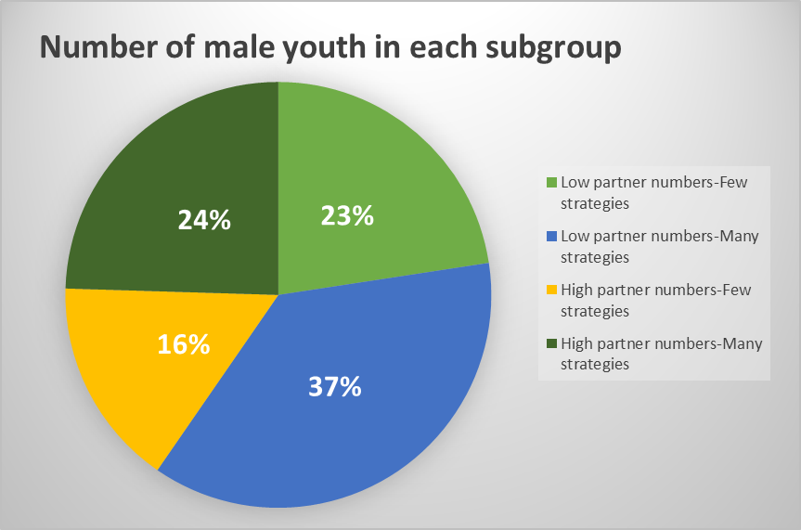

Slide 37
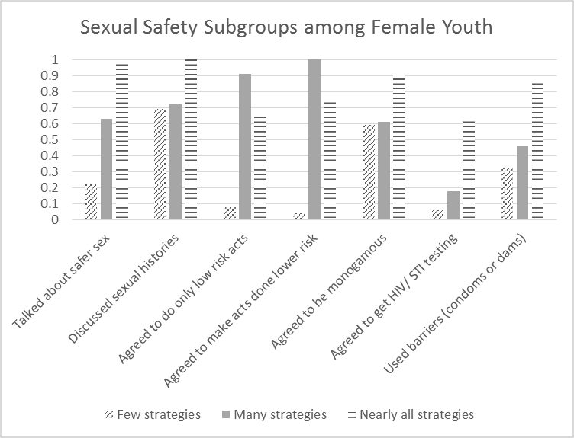

Slide 40
 | Latent class groups
 | Male youth (n = 208) |  |  |  |  |  |  |  | Female youth (n = 217)
 | Low Partner Numbers |  |  |  | High Partner Numbers
LCA indicator | Few Strategies (n = 47) |  | Many Strategies (n = 77) |  | Few Strategies (n = 33) |  | Many Strategies (n = 51) |  | Few Strategies (n = 77) |  | Many Strategies (n = 40) |  | Nearly All Strategies (n = 100)
Talked about safer sex | 0.21 |  | 0.82 |  | 0.62 |  | 0.91 |  | 0.22 |  | 0.63 |  | 0.99
Discussed sexual histories | 0.49 |  | 0.83 |  | 0.62 |  | 0.92 |  | 0.69 |  | 0.72 |  | 1.00
Agreed to do only low risk acts | 0.11 |  | 0.88 |  | 0.00 |  | 0.80 |  | 0.08 |  | 0.91 |  | 0.64
Agreed to make acts done lower risk | 0.07 |  | 0.85 |  | 0.05 |  | 0.91 |  | 0.04 |  | 1.00 |  | 0.74
Agreed to be monogamous | 0.22 |  | 0.71 |  | 0.54 |  | 0.84 |  | 0.59 |  | 0.61 |  | 0.90
Agreed to get HIV/ STI testing | 0.11 |  | 0.33 |  | 0.16 |  | 0.55 |  | 0.06 |  | 0.18 |  | 0.63
Used barriers (condoms or dams) | 0.24 |  | 0.67 |  | 0.64 |  | 0.77 |  | 0.32 |  | 0.46 |  | 0.86
Number of lifetime partners | 2.01 |  | 2.40 |  | 6.51 |  | 6.43 |  | 3.60 |  | 2.58 |  | 4.79

Slide 41
 | Latent class groups
 | Male youth (n = 208) |  |  |  |  |  |  |  | Female youth (n = 217)
 | Low Partner Numbers |  |  |  | High Partner Numbers
LCA indicator | Few Strategies (n = 47) |  | Many Strategies (n = 77) |  | Few Strategies (n = 33) |  | Many Strategies (n = 51) |  | Few Strategies (n = 77) |  | Many Strategies (n = 40) |  | Nearly All Strategies (n = 100)
Talked about safer sex | 0.21 |  | 0.82 |  | 0.62 |  | 0.91 |  | 0.22 |  | 0.63 |  | 0.99
Discussed sexual histories | 0.49 |  | 0.83 |  | 0.62 |  | 0.92 |  | 0.69 |  | 0.72 |  | 1.00
Agreed to do only low risk acts | 0.11 |  | 0.88 |  | 0.00 |  | 0.80 |  | 0.08 |  | 0.91 |  | 0.64
Agreed to make acts done lower risk | 0.07 |  | 0.85 |  | 0.05 |  | 0.91 |  | 0.04 |  | 1.00 |  | 0.74
Agreed to be monogamous | 0.22 |  | 0.71 |  | 0.54 |  | 0.84 |  | 0.59 |  | 0.61 |  | 0.90
Agreed to get HIV/ STI testing | 0.11 |  | 0.33 |  | 0.16 |  | 0.55 |  | 0.06 |  | 0.18 |  | 0.63
Used barriers (condoms or dams) | 0.24 |  | 0.67 |  | 0.64 |  | 0.77 |  | 0.32 |  | 0.46 |  | 0.86
Number of lifetime partners | 2.01 |  | 2.40 |  | 6.51 |  | 6.43 |  | 3.60 |  | 2.58 |  | 4.79

Slide 42
 | Latent class groups
 | Male youth (n = 208) |  |  |  |  |  |  |  | Female youth (n = 217)
 | Low Partner Numbers |  |  |  | High Partner Numbers
LCA indicator | Few Strategies (n = 47) |  | Many Strategies (n = 77) |  | Few Strategies (n = 33) |  | Many Strategies (n = 51) |  | Few Strategies (n = 77) |  | Many Strategies (n = 40) |  | Nearly All Strategies (n = 100)
Talked about safer sex | 0.21 |  | 0.82 |  | 0.62 |  | 0.91 |  | 0.22 |  | 0.63 |  | 0.99
Discussed sexual histories | 0.49 |  | 0.83 |  | 0.62 |  | 0.92 |  | 0.69 |  | 0.72 |  | 1.00
Agreed to do only low risk acts | 0.11 |  | 0.88 |  | 0.00 |  | 0.80 |  | 0.08 |  | 0.91 |  | 0.64
Agreed to make acts done lower risk | 0.07 |  | 0.85 |  | 0.05 |  | 0.91 |  | 0.04 |  | 1.00 |  | 0.74
Agreed to be monogamous | 0.22 |  | 0.71 |  | 0.54 |  | 0.84 |  | 0.59 |  | 0.61 |  | 0.90
Agreed to get HIV/ STI testing | 0.11 |  | 0.33 |  | 0.16 |  | 0.55 |  | 0.06 |  | 0.18 |  | 0.63
Used barriers (condoms or dams) | 0.24 |  | 0.67 |  | 0.64 |  | 0.77 |  | 0.32 |  | 0.46 |  | 0.86
Number of lifetime partners | 2.01 |  | 2.40 |  | 6.51 |  | 6.43 |  | 3.60 |  | 2.58 |  | 4.79

Slide 43
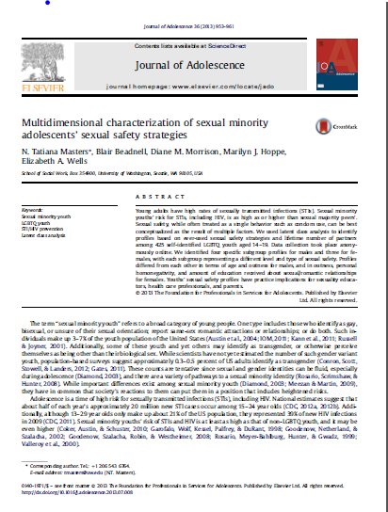
Want more details?
Masters, N.T., Beadnell, B., Morrison, D.M., Wells, E.A., and Hoppe, M.J. (2013). Multidimensional characterization of sexual minority adolescents’ sexual safety strategies. Journal of Adolescence, 36 (5), 953–961.

Slide 44
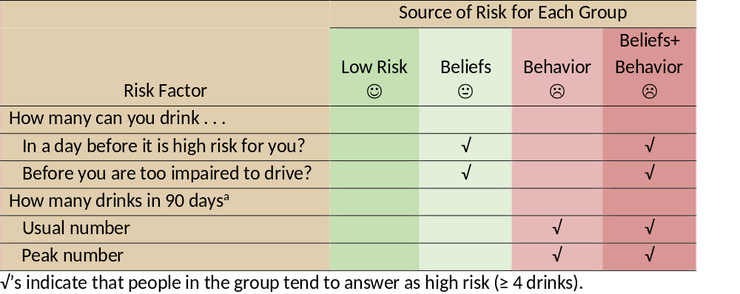
LCA identifying subgroups at two timepoints
B

Slide 45
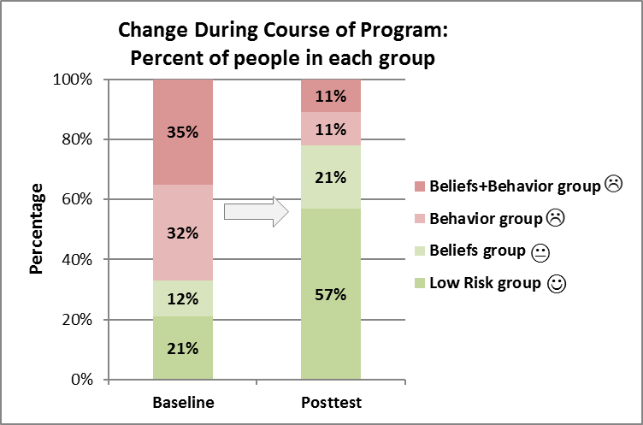
Subgroup membership as outcome:
Latent Transition Analysis (LTA)

Slide 46
Considerations In Subgroup Analyses

Slide 47
Analysis Strategies
Once subgroups are identified, use typical statistics that compare groups; e.g.:
For LCA and LTA: Find subgroups, then rerun model to do the comparisons
At one point in time
Regression
Longitudinal
Repeated measures ANOVA
Analysis of Variance (ANOVA)
Generalized Estimating Equation
Mixed Models

Slide 48
Sample size
Necessary
Sufficient sample size for each subgroup
Challenges
Even in very large samples, some subgroups may be too small to have statistical power for comparisons
Uneven subgroup sizes can result in confusing findings due to
  greater power for comparing the larger groups
  lower power for comparing the smaller groups

Slide 49
Uneven sample sizes
Made up example:
Group 1 and 2 significantly different from each other
Group 3 not significantly different from 1 and 2
one solution:
random sampling within larger subgroups to get relatively equal sizes
Outcome | Group 1 (n=3,000) | Group 2 (n=2,500) | Group 3 (n=150)
Binge drank, last 90 days | 10% | 19% | 40%

Slide 50
Longitudinal analyses of program effects
Common asking of the evaluation question:
“Do certain groups show less improvement than others?”
May not be that simple
Useful:
Visuals
Consideration of how to define ‘improvement’

Slide 51
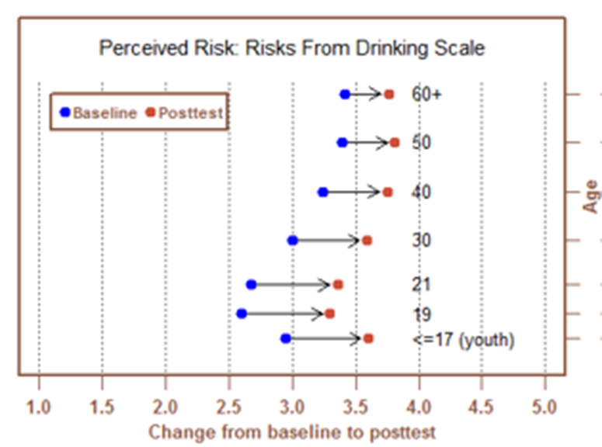
Interpreting findings: longitudinal analyses
Three factors to consider:
Where started
How much changed
Where ended

Slide 52
Evaluating intervention effectiveness
What are criteria for making conclusions about benefit and/or program success?
Ending the same?
Making the same amount of change?
Other?

Slide 53
How define how much a group benefits?
How much they changed? OR Where they end?
Who benefited the most?

Slide 54
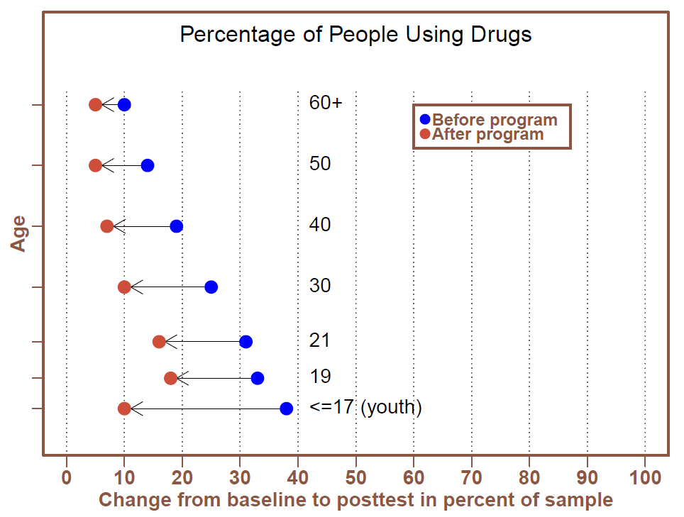
How define how much a group benefits?
Who benefited the most?

Slide 55
“Who benefits more (or less)?”
Not always the best question to gauge success
Helps to break into at least two questions
Several ways to frame, but for example:
  Who shows greater preintervention need?
  How much do they change compared to others?
  Do they continue to show greater need postintervention?

Slide 56
Communicating results can be challenging!
Need to communicate complex results effectively
Longitudinal data
    tables of means can be overwhelming
    complex stats may not be well understood

Slide 57


Simplify…

Slide 58
…but don’t OVER-simplify!
J: Next

Slide 59
Questions?
Comments?
Current challenges?

